Slide 1
Reading and writing data from/to SQL Server using Apache Spark

Slide 2
Prerequisite
A SQL Server Instance with 2 databases
Local Apache Spark env configured
Visual Studio Code (VS Code) with Pyspark installed and configured
Notes:
https://spark.apache.org/

Slide 3

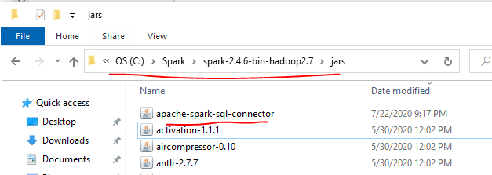
Download JDBC Connector for SQL Server
Step 1: Download Connector https://github.com/microsoft/sql-spark-connector/releases/tag/v1.0
Step 2: Copy this jar to jars folder under SPARK_HOME directory. e.g.

Slide 4
Thanks for watching!
Please leave a comment if you have any questions!
If you like this video, please hit the below LIKE button and Subscribe it..

